Slide 1
Usage of the Python Programming Language in the CMS Experiment
Rick Wilkinson (Caltech), Benedikt Hegner (CERN)
On behalf of CMS Offline & Computing

Slide 2
About Using Python
No top-down decision to use it
  Groups decided to use it on their own
  Probably influenced by what others are doing
Why people say they use Python
  Easy to learn
  Easy to understand syntax
  Good for rapid prototyping
  Lots of standard tools
  Lots of useful external tools
    cherrypy, PyRoot, PyQt
  Can do their scripting and their programming in one step
Notes:
C++ isn’t easy to learn
Perl syntax isn’t easy to understand
Industry practice is to use python for rapid prototype, C++ for implementation
Cherrypy for web, PyRoot for analysis, PyQt for GUIs
As opposed to separate scripting, in perl or shell

Slide 3
CMS Job Configuration
CMS jobs are defined by configuration files
  One executable, cmsRun, with many plug-in modules
  Not interactive
Release contains ~6000 configuration files
  4500 shared fragments
  1400 executable job configurations
Standard full-chain validation job defines:
  700 modules
  150 sequences of modules
  over 13,000 configurable parameters
    See O. Gutsche’s talk, “Validation of Software Releases For CMS”

Slide 4
Why Switch to Python?
Previously, CMS used a custom configuration language
  Parsed using flex/bison
  Fills C++ data structures
Users needed to be able to copy, share, and modify fragments
  Users customizing their job
  Production system splitting jobs, setting random seeds, etc.
Required a lot of effort to support these operations for all data types
  We underestimated the need for a full programming language, instead of just a declarative language

Slide 5
Design
Mimic look and feel of old configuration.
Result is a python data structure
  Again, not an interactive system
  Easy for production system to manipulate
Use boost::python to translate into a C++ data structure
See poster “Using Python for Job Configuration in CMS”

Slide 6
Added Benefits
Easier to debug
  Can dump configurations or add inline printouts
  Can check for syntax errors by compiling
    i.e. “python my_cfg.py”
Easier to build configs
  For example, naming your input file and output file consistently
  Don’t need, say, perl scripts to edit config files
Can use command-line arguments, and higher-level Python functions
Many free tools available
  See A. Hinzmann’s talk, “Visualization of the CMS Python Configuration System”

Slide 7
Meta Configurations
Building blocks of cmsRun workflows are independent steps like simulation, high level trigger or reconstruction
Special setups still demand simultaneous changes in all steps
  cosmic vs. collision
  full simulation vs. fast simulation
Use Python config API to create standard workflows for production and release validation
cmsDriver.py TTbar.cfi --step GEN,FASTSIM

Slide 8
CMS and PyROOT
CMS stores its data in ROOT files
Two main modes of analyzing event data files
  cmsRun as full framework
    Make a C++ Analyzer module which extracts data into a separate ROOT analysis file
  FWLite for read-only access
In FWLite, needed libraries are loaded via
auto-loader mechanisms
Class dictionaries are provided via ROOT/Reflex
Usable interfaces in C++ and Python

Slide 9
FWLite Example
from PhysicsTools.PythonAnalysis import *
from ROOT import *
# prepare the FWLite autoloading mechanism
gSystem.Load("libFWCoreFWLite.so")
AutoLibraryLoader.enable()
events = EventTree("reco.root")
# book a histogram
histo = TH1F("photon_pt", "Pt of photons", 100, 0, 300)
# event loop
for event in events:
photons = event.photons # uses aliases
print “# of photons in event %i: %i" % (event, len(photons))
for photon in photons:
if photon.eta() < 2:
histo.Fill(photon.pt())

Slide 10
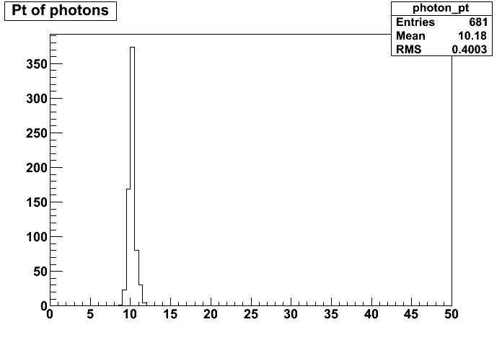
Analysis with FWLite
Simple script
  Almost pseudocode
To use, just say:
> python –i script.py
>>> histo.Draw()

Slide 11
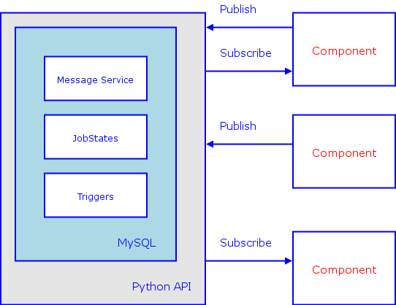
Production Workflows
All request and job management uses one Python framework
  Clusters of Python daemons
  Event-driven Message Service
  MySQL for persistency
See van Lingen & Wakefield’s poster,
“CMS production and processing system - Design and experiences”
Notes:
Spend more time on the picture

Slide 12
Data Management
Many web-based services:
  FileMover: see Valentin Kuznetsov’s talk
  SiteDB: see Simon Metson’s poster
  Data Quality Monitoring GUI: see Lassi Tuura’s talk
  Conditions Database GUI: see Antonio Pierro’s poster
All of these tools are consolidating into a standard framework
  See van Lingen & Wakefield’s talk, “Job Life Cycle Management libraries for CMS Workflow Management Projects ”

Slide 13
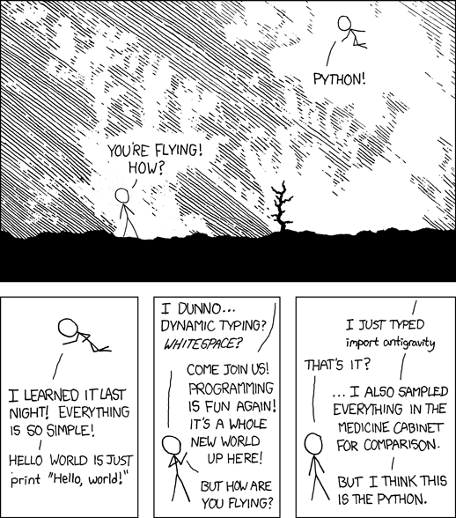
Conclusion
CMS uses Python extensively
  And we like it
A variety of activities
  Scripting
  Job Configuration
  Analysis
  GUIs
  Web interfaces
  Message passing
  Database interfaces
Notes:
Xkcd cartoon

